Slide 1

RUNGTA COLLEGE OF DENTAL SCIENCES & RESEARCH
TITLE OF THE TOPIC: COMPLEXAMALGAM RESTORATION
DEPARTMENT OF CONSERVATIVE DENTISTRY AND ENDODONTICS

Slide 2
Specific learning Objectives
At the end of this presentation the learner is expected to know ;
Core areas* | Domain ** | Category #
RESISTANCE AND RETENTION FORM | COGNITIVE | MUST NOW
INDICATIONS AND CONTRAINDICATION ADVANTAGES AND DISADVANTAGES | PSYCHOMOTOR | NICE TO KNOW
TYPES OF AMALGAM RESTORATION | AFFECTIVE | DESIRE TO KNOW

Slide 3
CONTENTS
Introduction
Indications and contraindications
Factors to be considered.
Advantages and disadvantages
Pin retained amalgam restorations
Tooth preparation for pin retained amalgam restorations
Retentive pins
Mechanical aspect of pin retained restoration

Slide 4
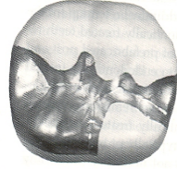
FINAL TOOTH PREPARATION
In this step any infected carious dentin or old restorative material is removed.
A liner is then be applied but should not extend closer than 1 mm to a slot or pin.
Coves and locks can also be prepared to act as auxiliary retention form. Coves should be prepared in a horizontal plane and locks should be prepared in a vertical plane.
They should be prepared before preparing pin holes and inserting pins .

Slide 5
LOCKS AND COVES
To enhance retention form of the proximal portion,proximal locks may be indicated to counter proximal displacement.
retentive locks may not be needed in conservative, narrow proximal boxes.
RETENTION LOCK
No. 169L bur or NO ¼ bur used with air coolant (to improve vision) and reduced speed (to improve tactile “feel” and control).
The bur is placed in the properly positioned axiolingual line angle and directed (i.e., translated) to bisect the angle approximately parallel to the DEJ

Slide 6
This positions the retention lock 0.2mm inside the DEJ, maintaining the enamel support.
The bur is tilted to allow cutting to the depth of the diameter of the end of the bur at the point angle and permit the lock to diminish in depth occlusally, terminating at the axiolinguopulpal point angle.

Slide 7
prepare the facial lock in the axiofacial line angle.
When the axiofacial and axiolingual line angles are less than 2 mm in length, the tilt of the bur is reduced to make prox lock disappear midway between the DEJ and the enamel margin

Slide 8
CHARACTERISTICS OF PROXIMAL LOCKS
Position
The retention locks should be placed 0.2 mm inside the DEJ, regardless of the depth of the axial walls and axial line angles.
Translation
refers to the direction of movementof the axis of the bur.
Depth
refers to the extent of translation (i.e., 0.5 mm at gingival floor level).

Slide 9
OCCLUSOGINGIVAL ORIENTATION
refers to the tilt of the No. 169L bur,which dictates the occlusal height of the lock, given a constant depth.
it is essential not to prepare the locks entirely in the axial wall (i.e., incorrect translation [moving the bur only in a pulpal direction]) because no effective retention is obtained, and there is a risk of pulpal involvement.

Slide 10
RETENTION GROOVE
It is prepared by placing a No. 1⁄4 bur (rotating at low speed) in the axiofaciogingival point angle
It is positioned in the dentin to maintain 0.2 mm of dentin between the groove and theDEJ.
move the bur lingually along the axiogingival line angle, with the angle of cutting generally bisecting the angle between the gingival and axial walls.

Slide 11
Ideally, the direction of the gingival groove is slightly more gingival than axial (and the direction of an incisal groove would be slightly more incisalthan axial

Slide 12
GINGIVAL COVES
Alternatively, less retention form is needed, two gingival coves may be used, as opposed to a continuous groove
One each may be placed in the axiogingivofacial and axiogingivolingual point angles
The bur is 0.5 mm, and the depth of the groove should be half this diameter (0.25 mm)

Slide 13
INCISAL RETENTION COVE
At the axiofacioincisal point angle with a No. 1⁄4 bur in dentin, being careful not to undermine the enamel.
It is directed similarly into the incisal point angle and prepared to half the diameter of the bur
Undermining the incisal enamel (or incisal canopy) should be avoided.
For the maxillary canine, the palm-and-thumb grasp may be used to direct the bur incisally

Slide 14
Classification of Pins:
DIRECT PINS/ NON PARALLEL PINS
a) Cemented pins
b) Friction Lock pins
c) Self threading pins
2) INDIRECT PINS/PARALLEL PINS
a) cast gold pins
b) Wrought precious metal pins

Slide 15
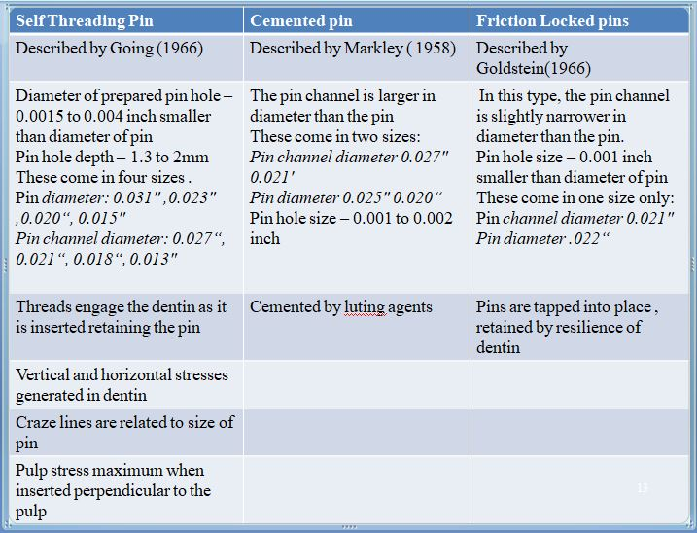

Slide 16
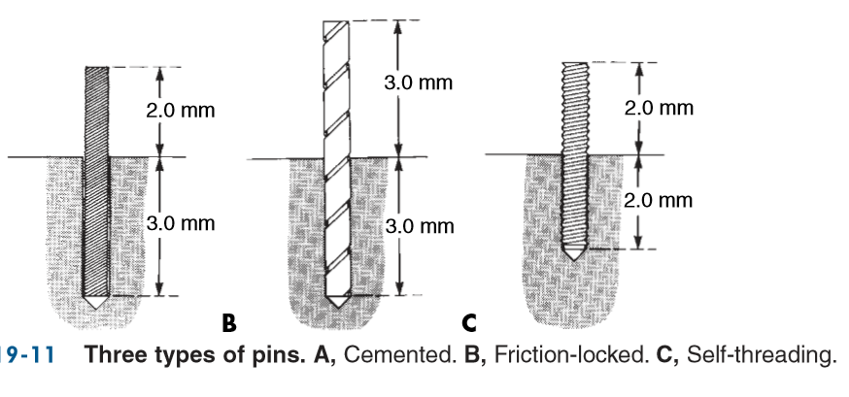

Slide 17
INDIRECT PINS:
Made smaller in size when compared to their pin holes
They constituted an integral part of cast restoration.
parallel pins ➔ these pins are placed parallel to each other and also path of insertion of the restoration.
DIRECT PINS:
Inserted in to dentin after this restoration is placed directly over them.
Also called nonparallel pins because they are inserted directly in to tooth structure and need not be parallel.

Slide 18
PIN MATERIAL
Stainless steel
Silver
Titanium
Cast gold alloys
Platinum-iridium
Plastic
Aluminium
Acrylic
Platinumpalladium

Slide 19
Stainless steel, titanium and silver pins → direct/non-parallel techniques
stainless steel→ pH is stronger than its gold and titanium counter parts
corrosive and
non-adhere to silver amalgam and composite resin restorative materials.
Titanium pins → least corrosive and most compatible of the metals
strength and modulus of elasticity is less compared to that of stainless steel and high gold content alloy

Slide 20
Do not show any adherence to silver amalgam composite restorative materials.
Silver pins → form a true adhesive bond between the pin and silver amalgam material so as to render them an integral part of restoration.

Slide 21
cast gold, platinum, palladium, or platinum-indium,plastic pin →
indirect/parallel pin technique.
relatively corrosive resistant
Plastic pins → part of the final restoration.
Used for taking impression of the pin holes for fabricating a cast gold alloy restoration.
Aluminium pins → for retaining a temporary restoration until the final restoration is fabricated and inserted.

Slide 22
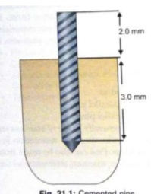
Retentive pin
Cemented pin
Introduced by Markeley (1958)
Pin channel is larger in diameter than pin
Available in 2 sizes
Pin channel diameter Pin diameter
A. 0.027” 0.025”
B. 0.021” 0.020”

Slide 23
INDICATION:
In case where least stresses or crazing is desired eg:endodontically treated teeth.
When bulk of dentin to hold the pin is less.
When dentin has lost its elasticity because of dehydration or sclerosis.
When pin has to be placed near dentino enamel junction
Technique for cross linkage of 2 part of same tooth

Slide 24
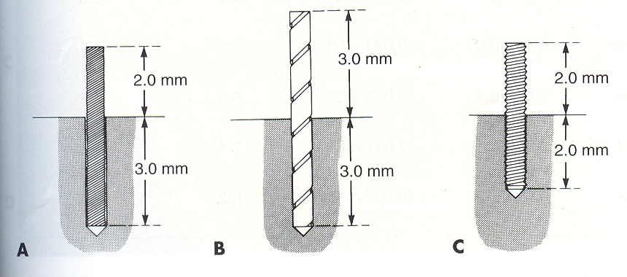
FRICTION GRIP/FRICTION LOCKED PINS
Introduced by Goldstein (1966)
Pin channel is slightly narrower than pins
Pin channel diameter Pin diameter
0.021” 0.022”
Indication:
Vital teeth
Periodontally sound teeth.
When direct access is possible so that the tapping force can be applied parallel to the long axis of the pins.
When sufficient amount of dentin is available to surround the pin.(4mm)
Pin should be located atleast 2.5mm from DEJ

Slide 25
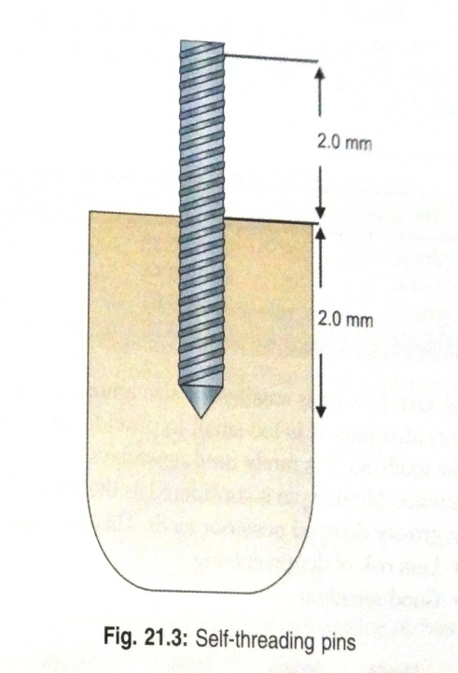
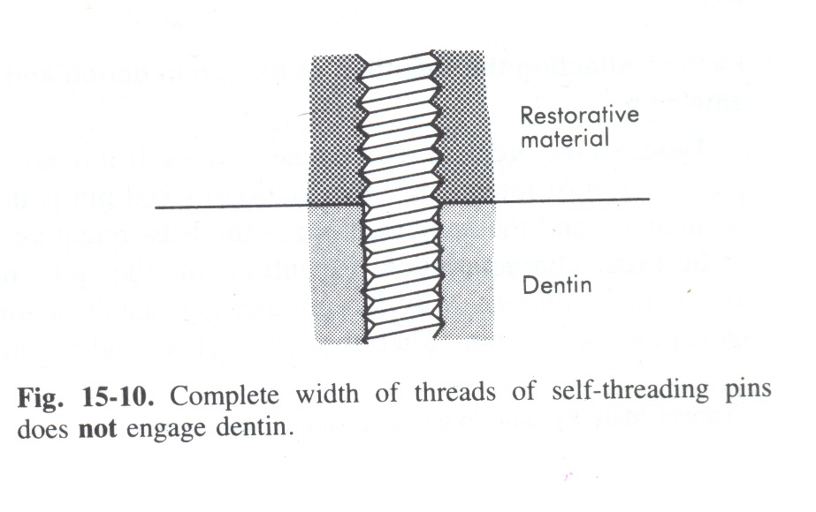
SELF THREADING PINS
Described by Going (1966)
Most commonly used.
The diameter of the prepared pinhole is 0.0381 to 0.1016 mm smaller than the diameter of the pin
the threads engage dentin as the pin is inserted,
Notes:
three to six times more retentive than
cemented pins

Slide 26
the elasticity of dentin permits insertion of a threaded pin into a hole of smaller diameter
threads of self-threading pins do not engage dentin for their entire width,
self-threading pins are the most retentive of the three types of pins
Recommended pinhole depth is generally accepted to be 2 mm.

Slide 27
Pin channel diameter Pin diameter
A. 0.027” 0.031”
B. 0.021” 0.023”
C. 0.018” 0.020”
D. 0.013” 0.015”

Slide 28
Several types of self-threading pins are available like, - Centerlok pin , Dolphin Retention Aid ,Reten pin , Stabilok Pin and Thread Mate System
INDICATION
Vital teeth.
When maximum retention is required.
When sufficient amount of dentin is available to surround the pins.
When minimum number of pin needed for restoration
Available pin location is at least 1.5mm from DEJ

Slide 29
CEMENTED PINS | FRICTION LOCKED PINS | SELF THREADED PINS
Stainless steel with threads or serrations | Stainless steel with threads | Stainless steel/Titanium with gold plating
Pin channel 0.001-0.002’’(0.025-0.05mm)larger than pin size | Pin channel is 0.001’’(0.025mm)smaller than pin size | Pin channel is 0.0015” to 0.004” smaller than pin size
Luted with standard luting agents | Taped into place with mallet | Placed by hand wrench or contra angle hand piece
Ease of placement | Pin placement is difficult | Pin placement is easy

Slide 30
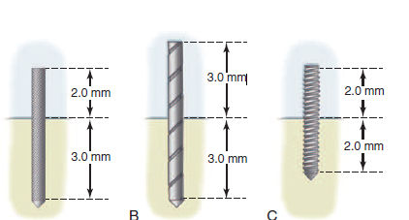
CEMENTED PINS | FRICTION LOCKED PINS | SELF THREADED PINS
Less internal stresses | Increased internal stress | Increased internal stresses
Least retentive Pin depth in dentin 3-4 mm In amalgam 2mm | 2-3 times more retentive than cemented pins Pin depth in dentin 3mm In amalgam 3mm | 5-6 times more retentive than friction locked pins Pin depth in dentin 2mm In amalgam 2mm

Slide 31
THE THREAD MATE SYSTEM (TMS)
TMS (Coltene/ Whaledent Inc., Mahwah, NJ) is the most widely used self-threading pin because of its
(1) versatility
(2) wide range of pin sizes
(3) color-coding system
(4) greater retentiveness and
(5) gold-plated surface ﬁnish, which may eliminate the possibility of corrosion
Factors which determine selection of the appropriate size of pins are the amount of dentin available to safely receive the pin and the amount of retention desirable

Slide 32
TAKE HOME MESSAGE
Because of its history, the complex amalgam restorations may be the most frequently placed complex restoration.
However due to the increasing benefits of composites, the many types of auxiliary retention forms available, and the variations of tooth preparations required for complex restorations, the operator should be familiar with all of these techniques, if he or she is to use these restorations on a regular basis.

Slide 33
QUESTIONS
WHAT ARE RETENTION GROVES
COVES
FINAL TOOTH PREPARATION

Slide 34
REFERENCES:
1. Sturdevant's Art and Science of Operative Dentistry - fourth Edition
2. Operative Dentistry - Modern theory and practice - First Edition- M.A. Marzouk
3. Text book of operative dentistry - Vimal K. Sikri
4.Fundamentals of Operative Dentistry- Summit JB- 2nd edition
5.Text book of operative dentistry → nisha carg,amit carg
6.Principles and Practice of Operative Dentistry-Gerald T. Charbeneau-Third edition.
7.Clinical operative dentistry-principles and practice→ramya Raghu,Raghu sreenivasan

Slide 35
THANK YOU

